Slide 1
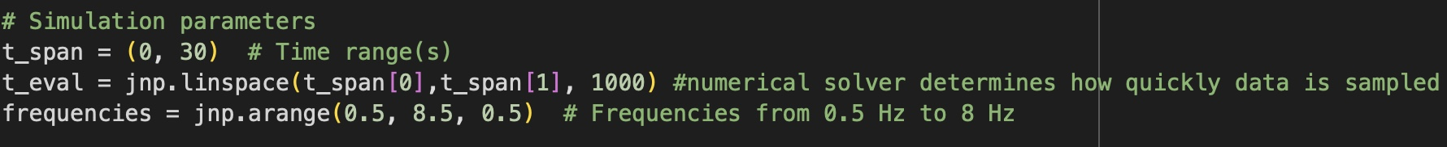
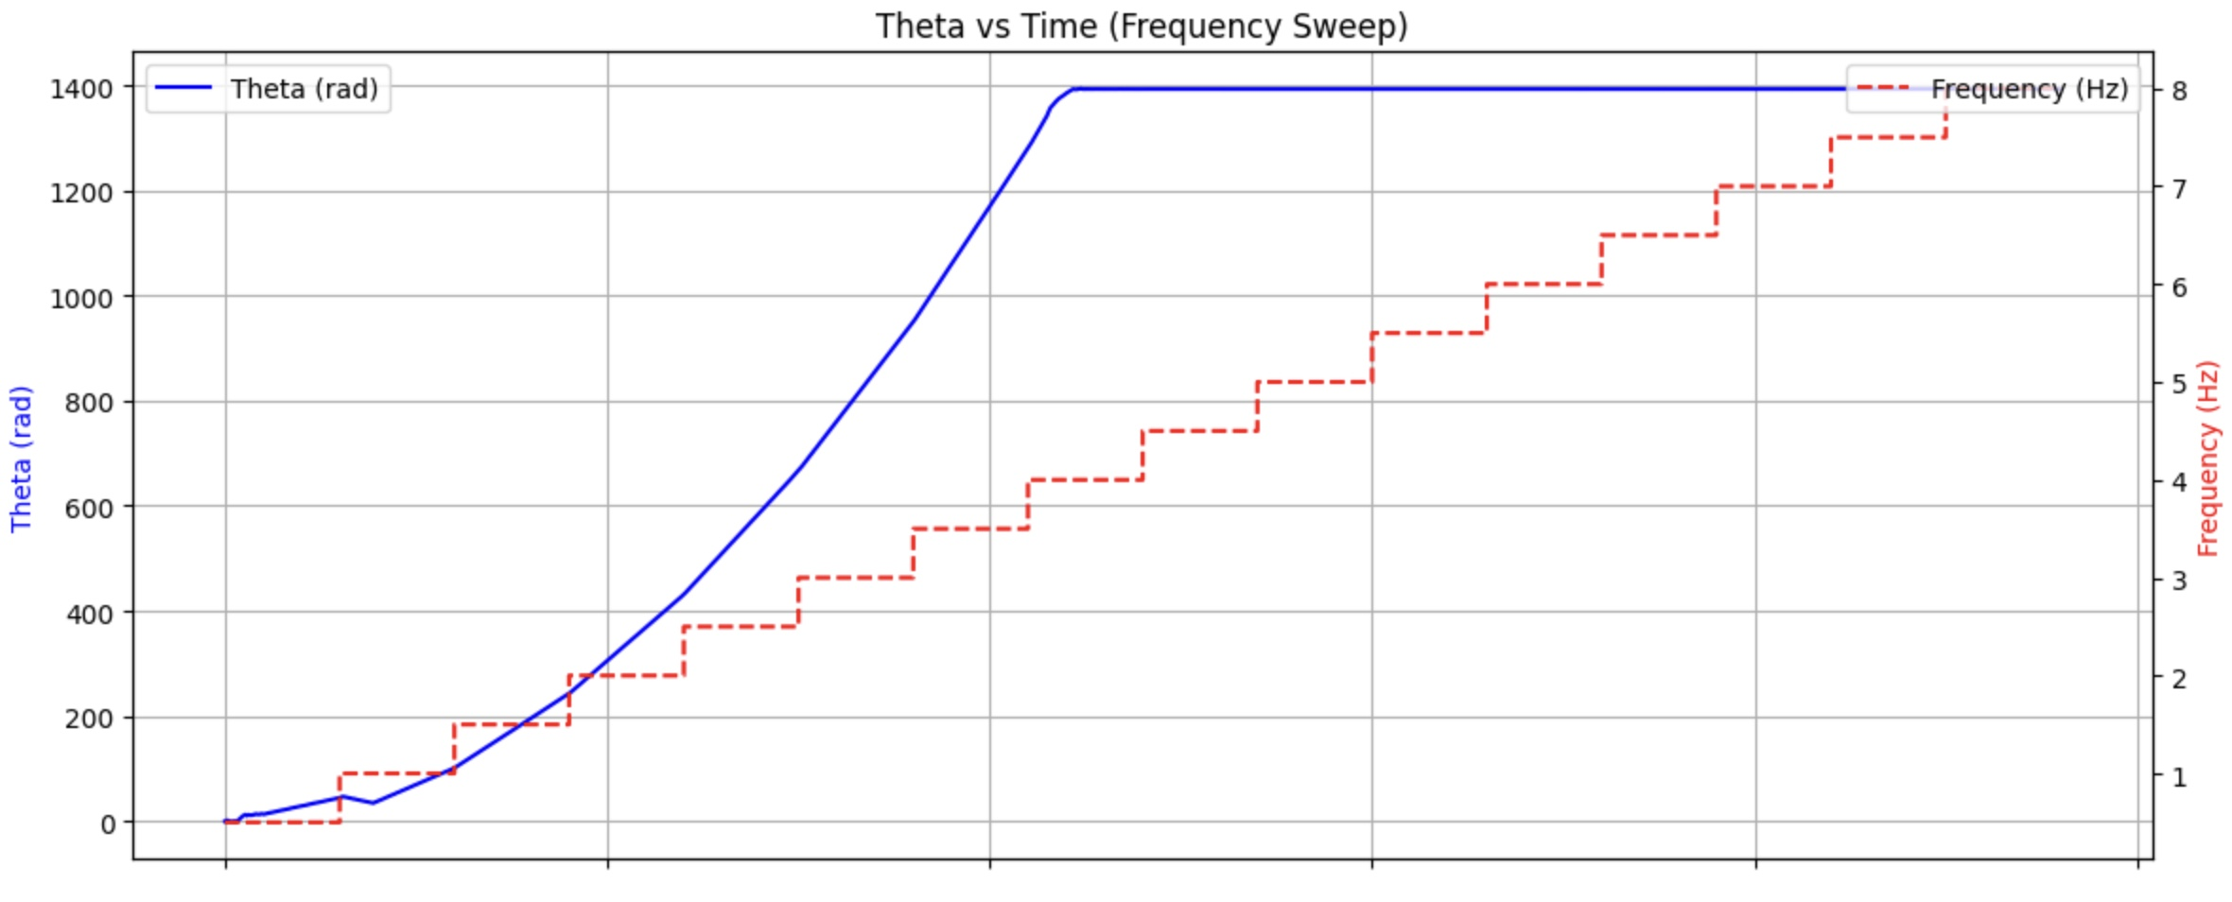
Experimenting with Parameters of Rotor System

Slide 2
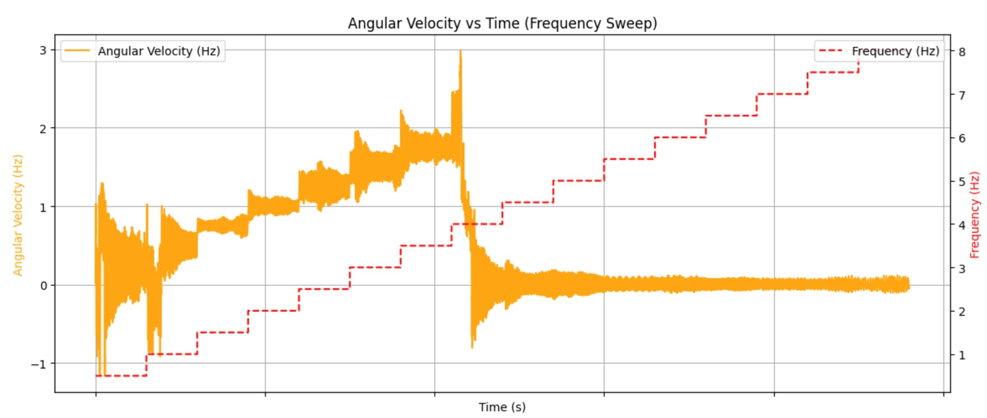
Experimenting with Parameters of Rotor System

Slide 3
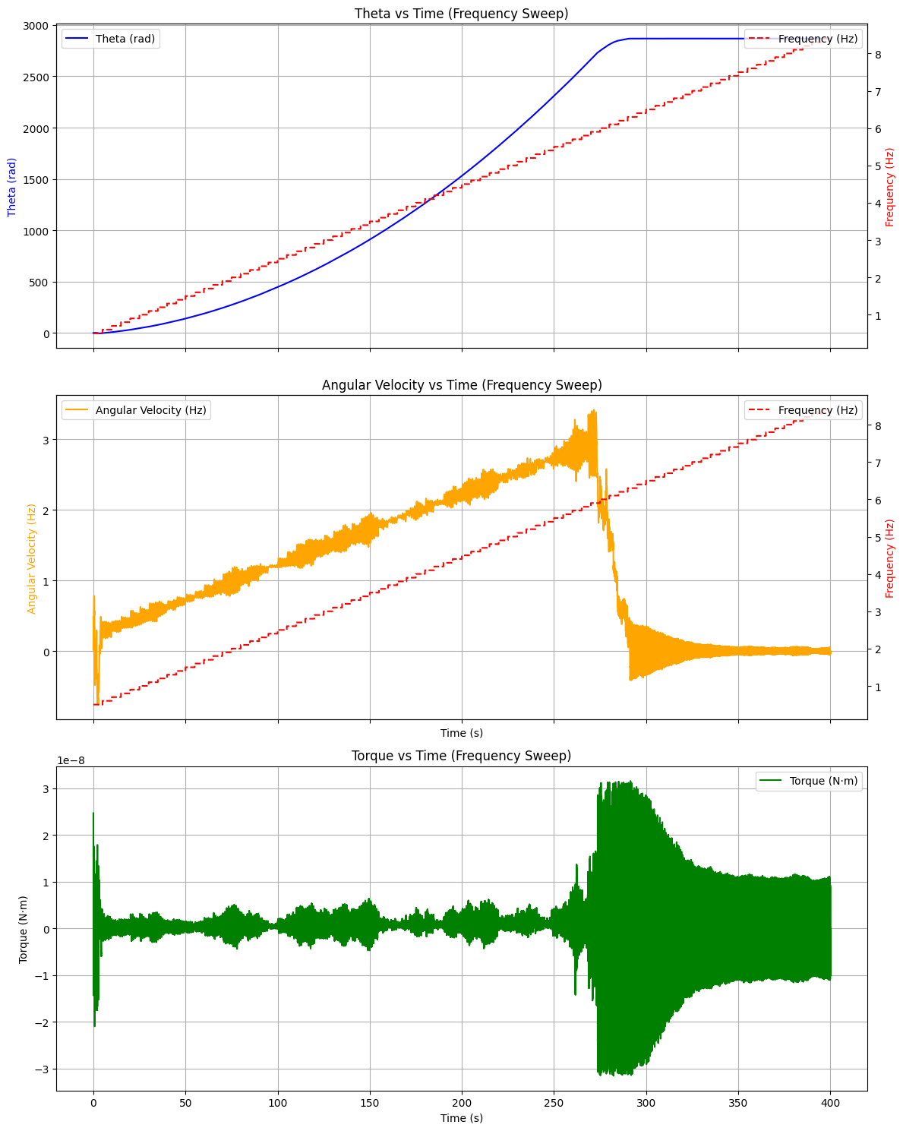
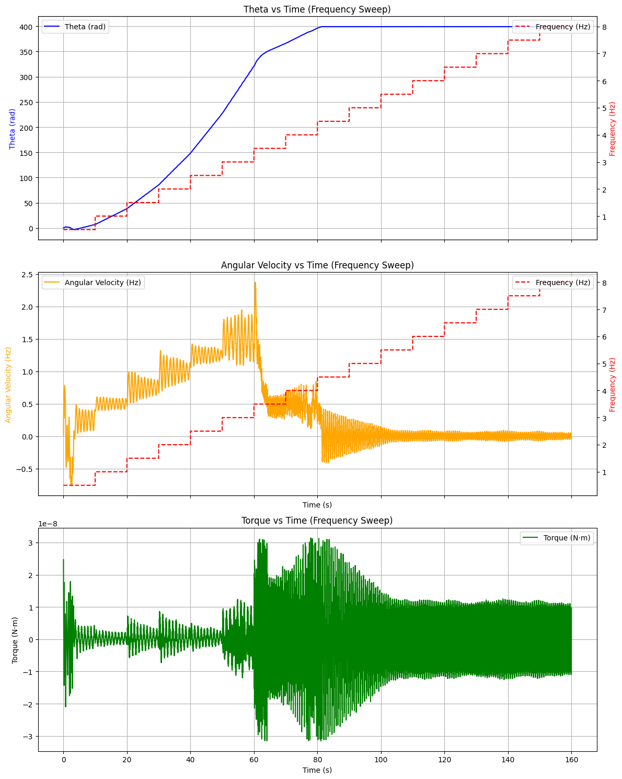
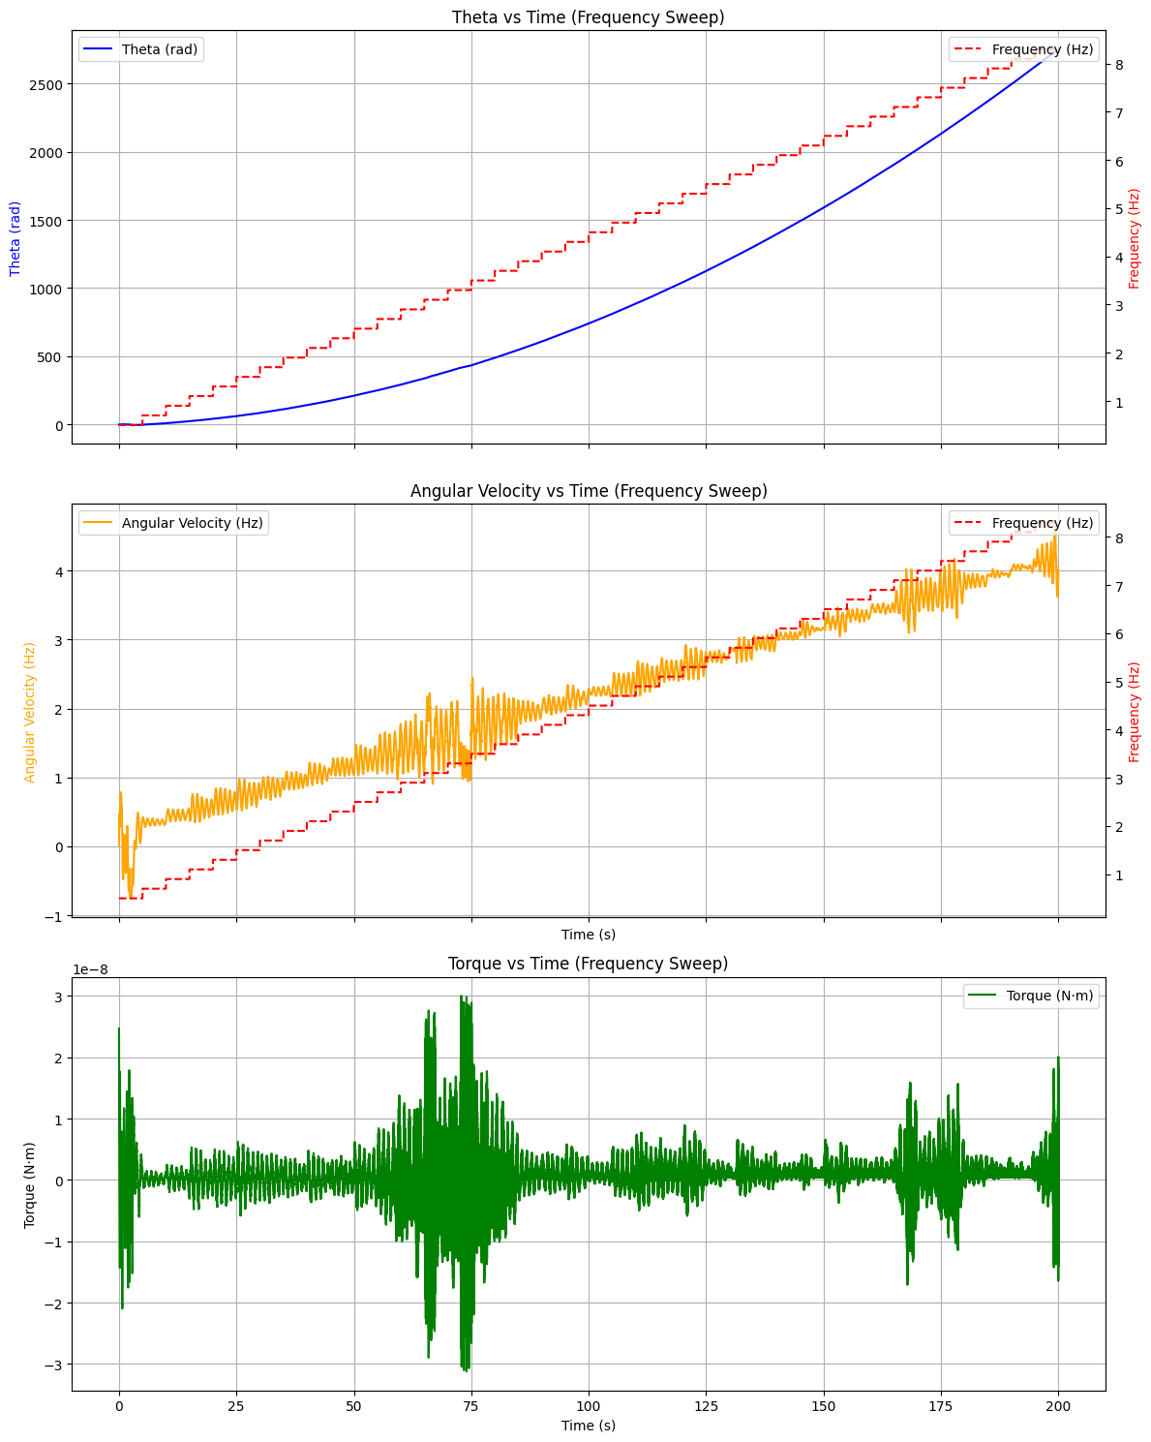
Experimenting with Parameters of Rotor System
0.1 Hz step-up every 5s
0.5 Hz step-up every 10s
0.2 Hz step-up every 5s
Max just under 3 Hz
Max ~ 1.5 Hz
Max ~ 4 Hz

Slide 4
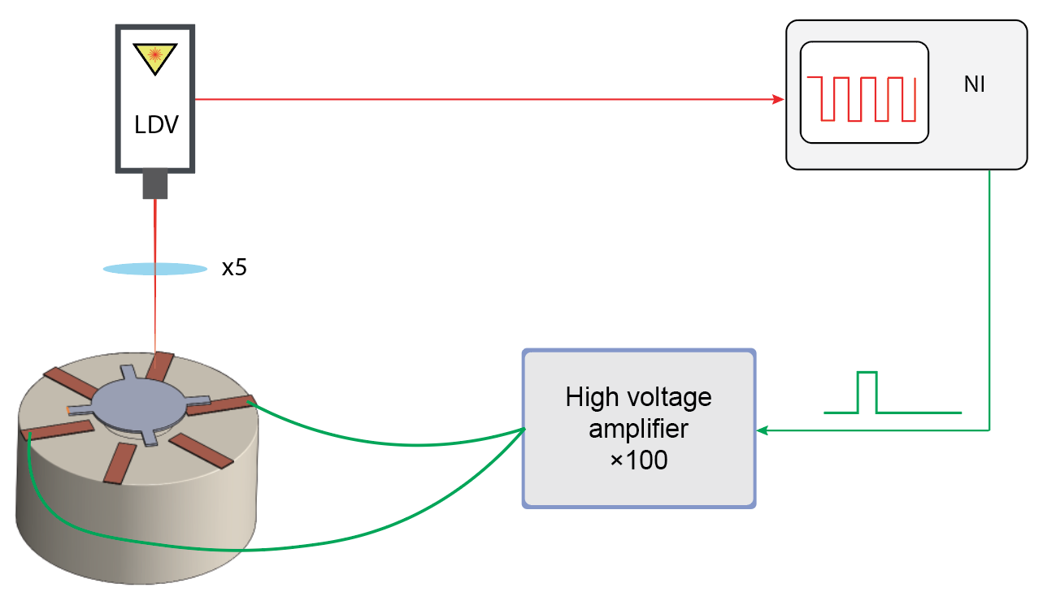
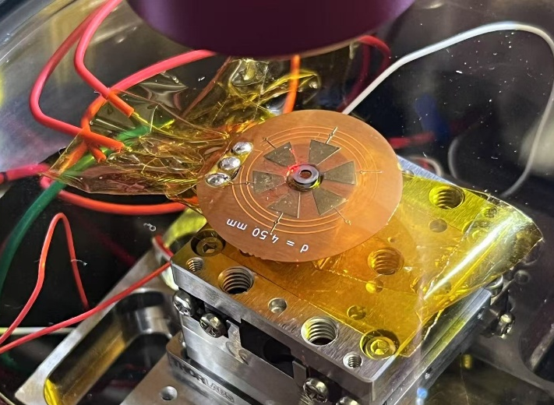
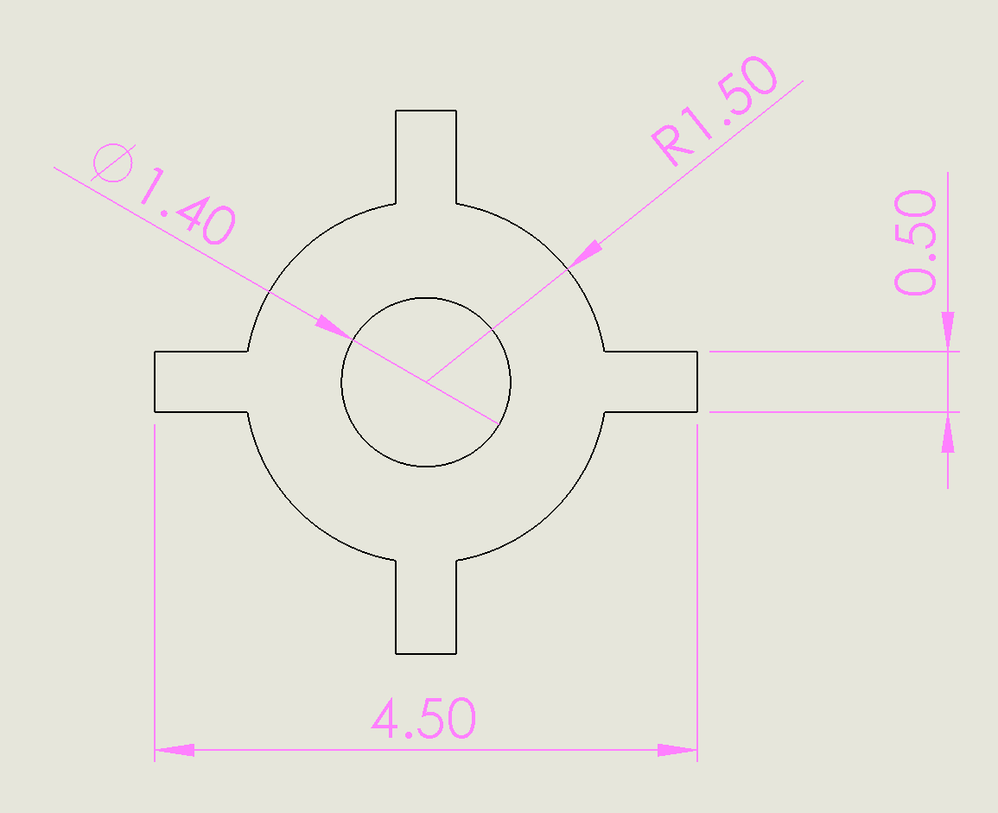
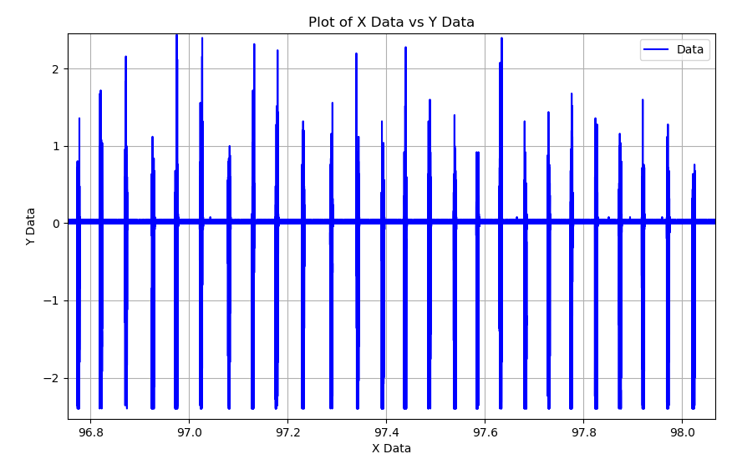
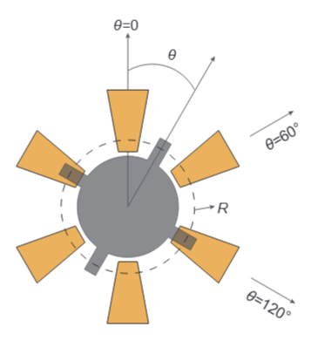
Measurement setup and strategy – Shared Before
Real shape of rotor, thickness=0.32mm
Trigger mode control strategy: When the LDV signal is higher than 0.2,
Electrode 3 are on.
1
3
LDV signal delay: 400us
Qns:
What sort of driving waveforms can we do [What is the frequency of the waveform]? Can we assume Torque is a function of theta and magnitude of the Voltage at each electrode at each time t?
Can we get the experiment data to mark the time when LDV signal is higher than 0.2 (so we can mark theta = 0 and start of applied waveform?
3
1
LDV signal, raw data

Slide 5
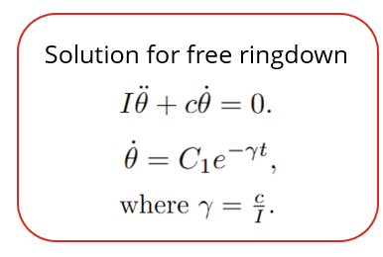
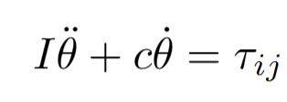
Electrode-Driven Rotor System
Experiment with simulation parameters (driving frequency, sampling points) to explore the physical system.
Build a simple neural network that predicts the torque on the rotor given Voltage on electrodes and electrode Theta (2 inputs sufficient?)
Will work on implementing a learned missing physics component for the simple dynamical model
To learn a torque model from experiments
Value obtained from ringdown experiments?
Will it make sense for I or c to be theta or V dependent?

Slide 7
Electrodes-Driven Rotor System
Objectives in the past week
Experiment with simulation parameters (driving frequency, sampling points) to explore the physical system.
Build a simple neural network that predicts the torque of the entire system given fixed time, frequency with varying theta.
Ideas for next step in implementing the APHYNITY Model
FINAL GOAL: Develop a neural network that identifies missing physics of the system. Run experiments with collaborators. Room for creative extensions of project.

Slide 8
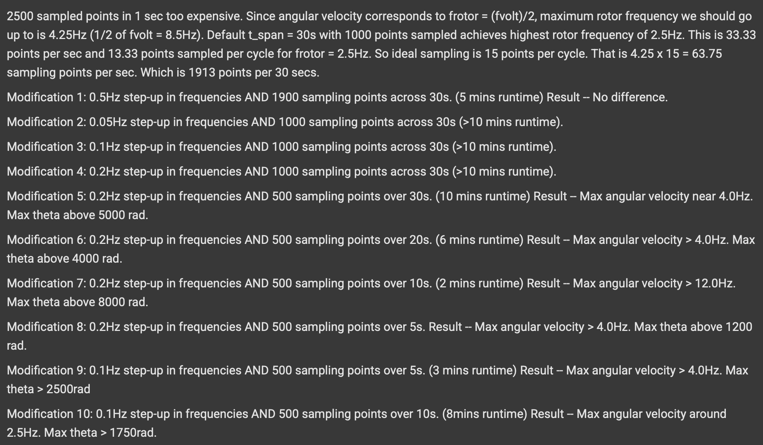
Experimenting with Parameters of Rotor System

Slide 9
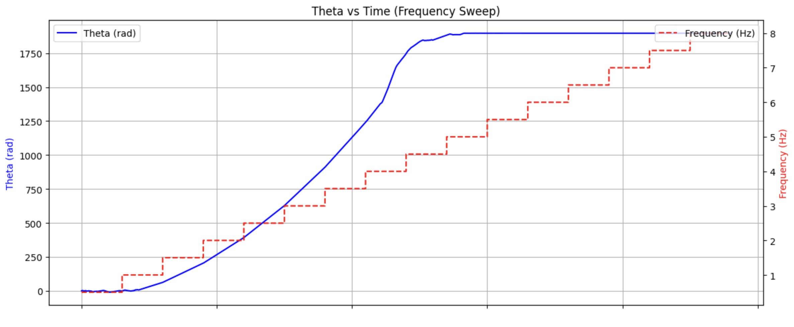
Experimenting with Parameters of Rotor System
Best Result: time_span = 30s, driving frequency step = 0.5Hz, number of sampling points = 73.33 per second

Slide 10
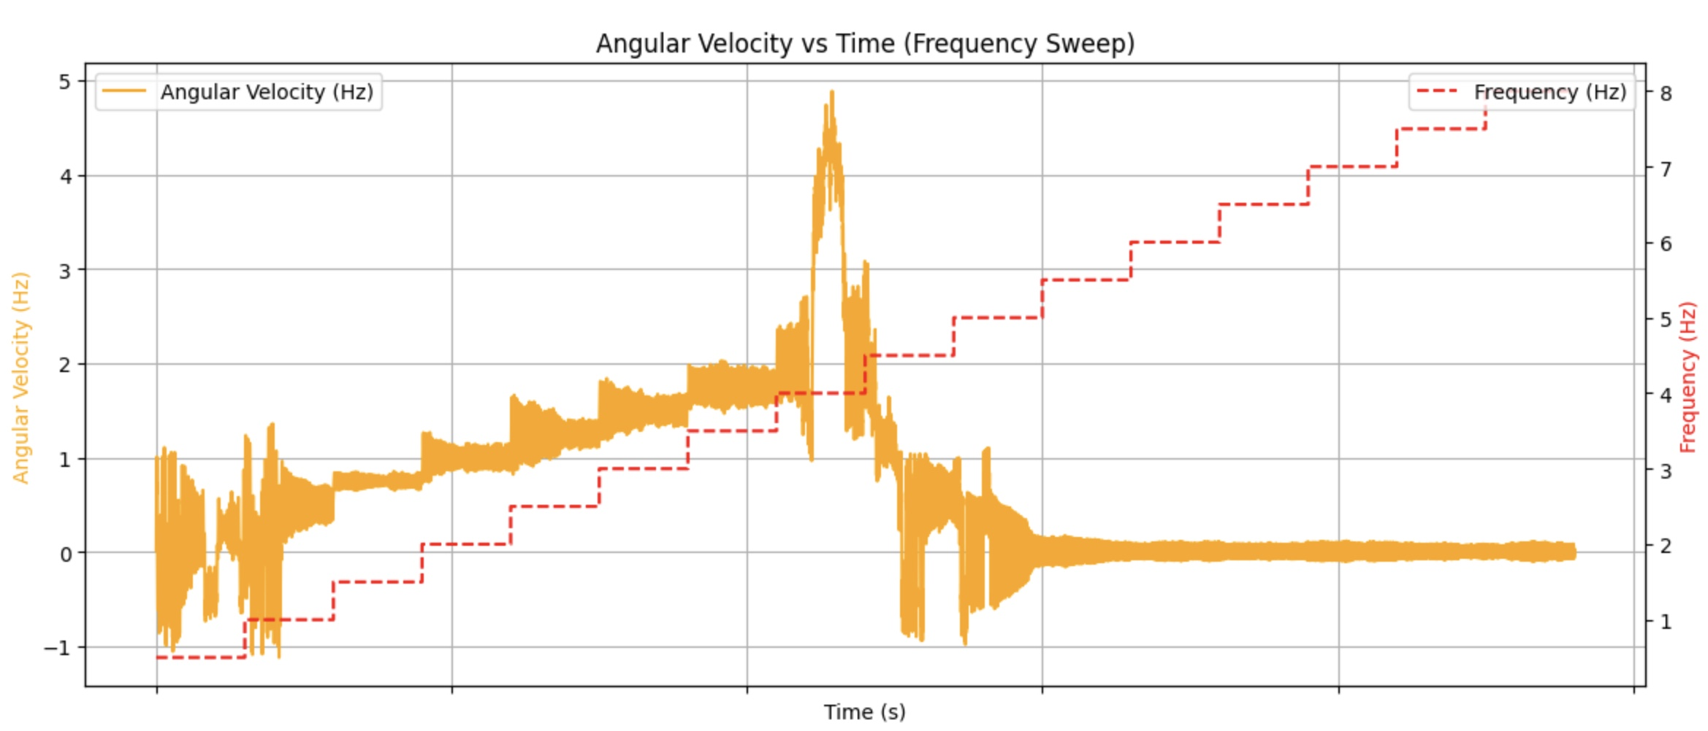
Experimenting with Parameters of Rotor System
Best Result: time_span = 30s, driving frequency step = 0.5Hz, number of sampling points = 73.33 per second

Slide 11
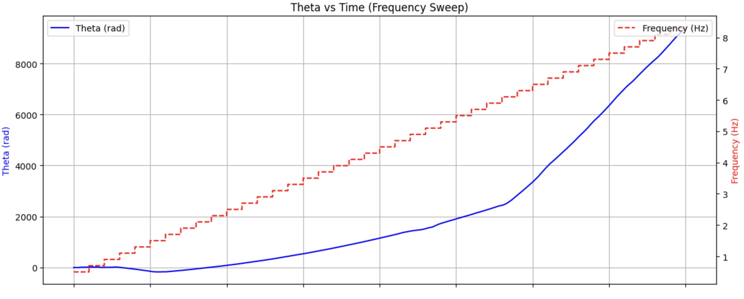
Experimenting with Parameters of Rotor System
Best Result: time_span = 10s, driving frequency step = 0.2Hz, number of sampling points = 50 per second

Slide 12
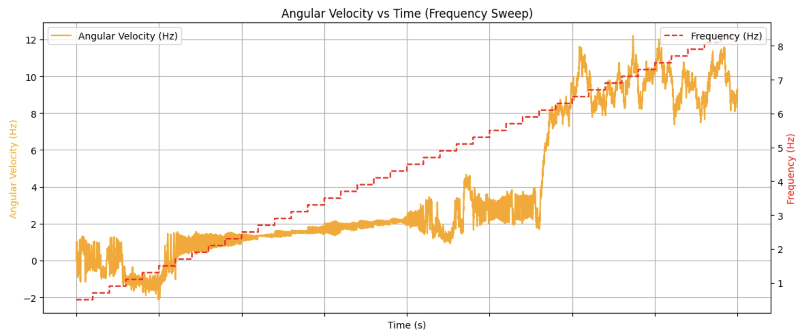
Experimenting with Parameters of Rotor System
Best Result: time_span = 10s, driving frequency step = 0.2Hz, number of sampling points = 50 per second

Slide 13
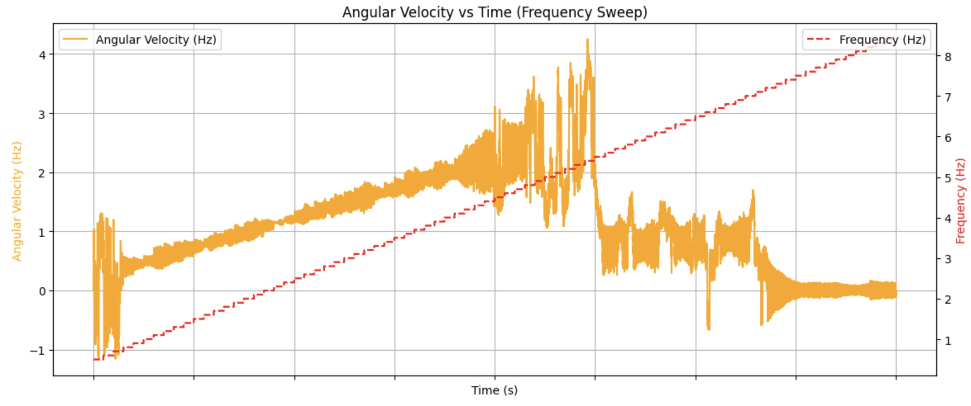
Experimenting with Parameters of Rotor System
time_span = 5s, driving frequency step = 0.1Hz, number of sampling points = 100 per second

Slide 14
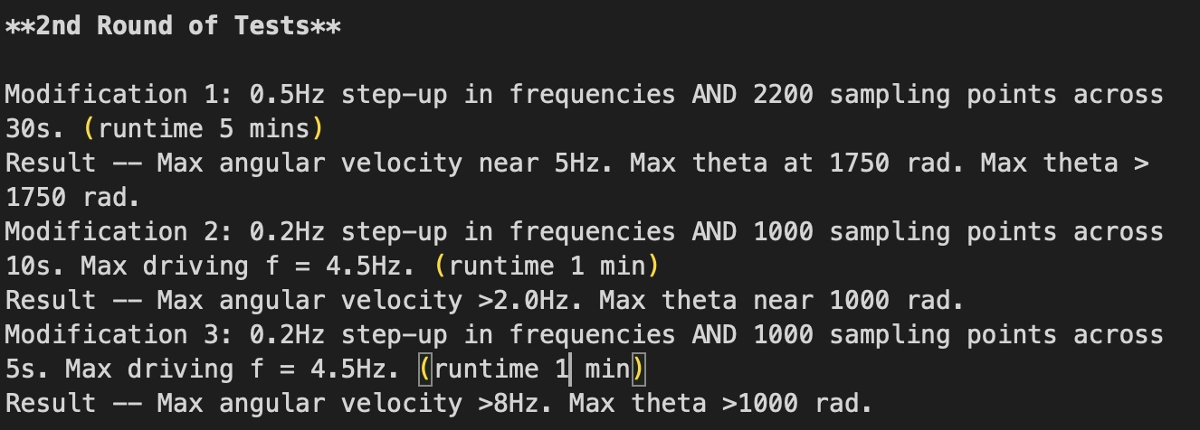
Experimenting with Parameters of Rotor System

Slide 15
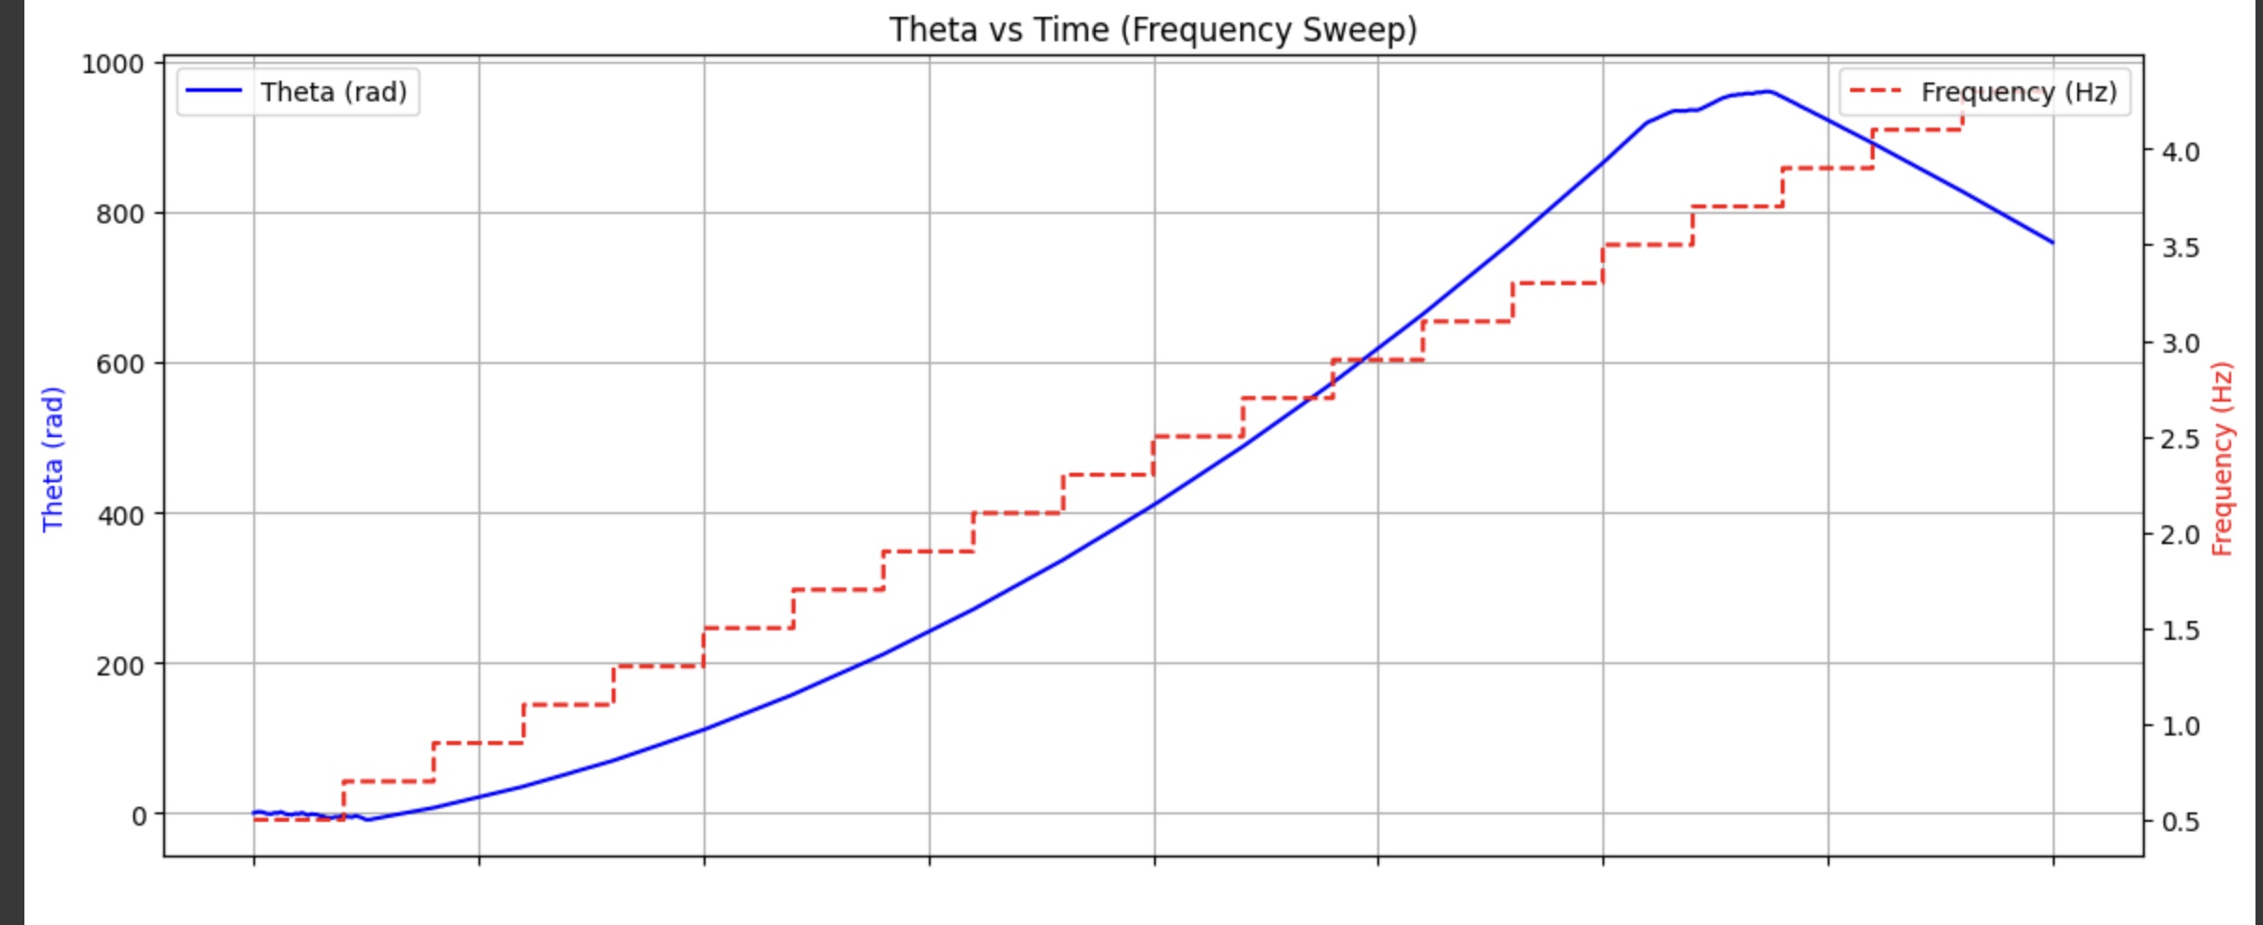
Experimenting with Parameters of Rotor System
time_span = 10s, driving frequency step = 0.2Hz, number of sampling points = 100 per second

Slide 16
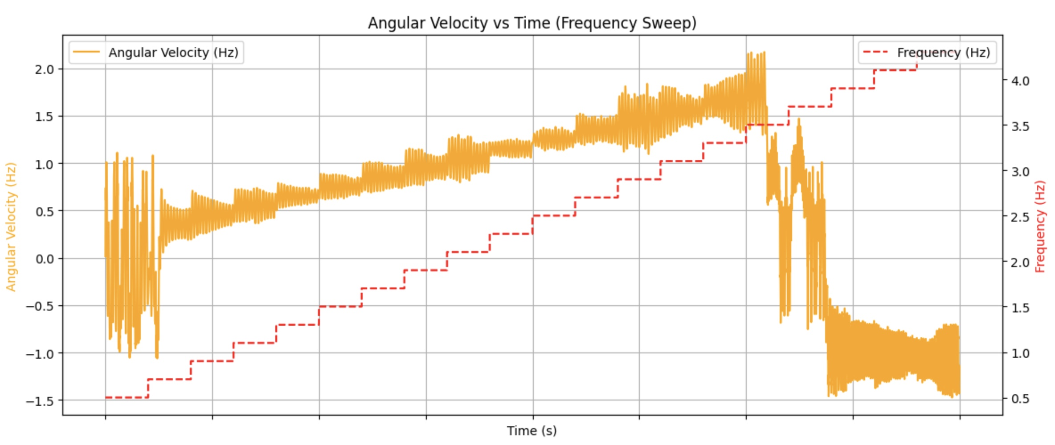
Experimenting with Parameters of Rotor System
time_span = 10s, driving frequency step = 0.2Hz, number of sampling points = 100 per second

Slide 17
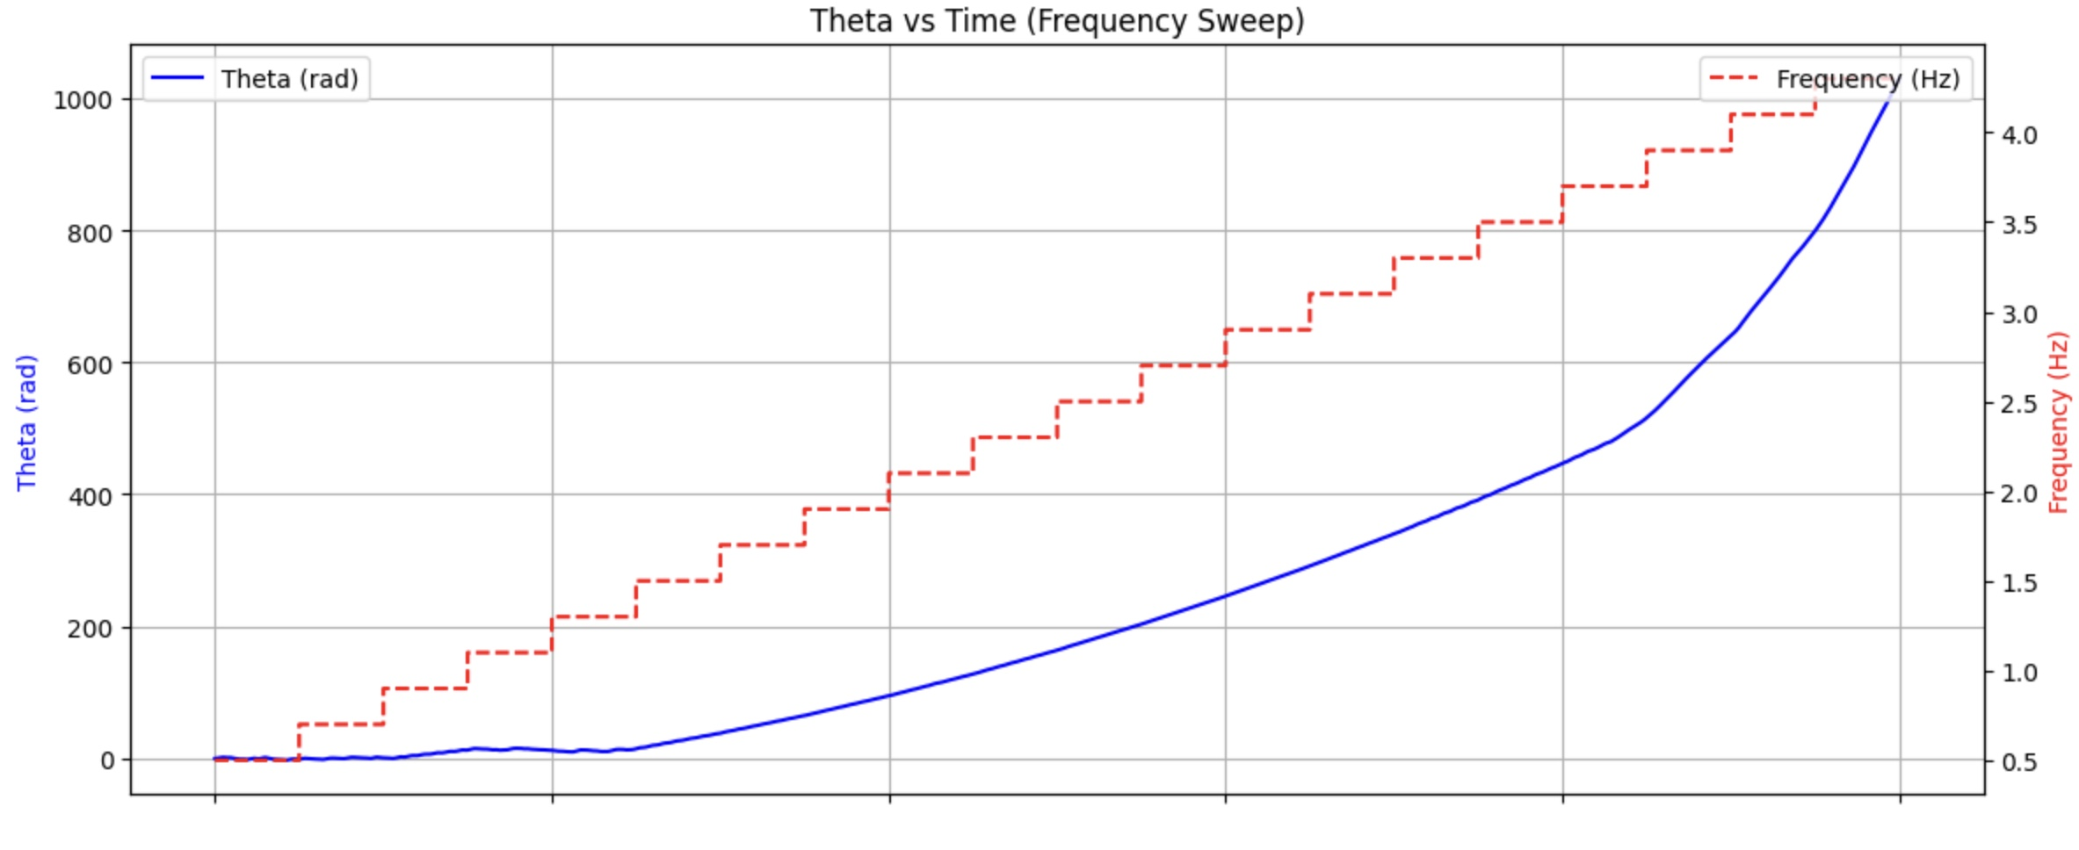
Experimenting with Parameters of Rotor System
time_span = 5s, driving frequency step = 0.2Hz, number of sampling points = 200 per second

Slide 18
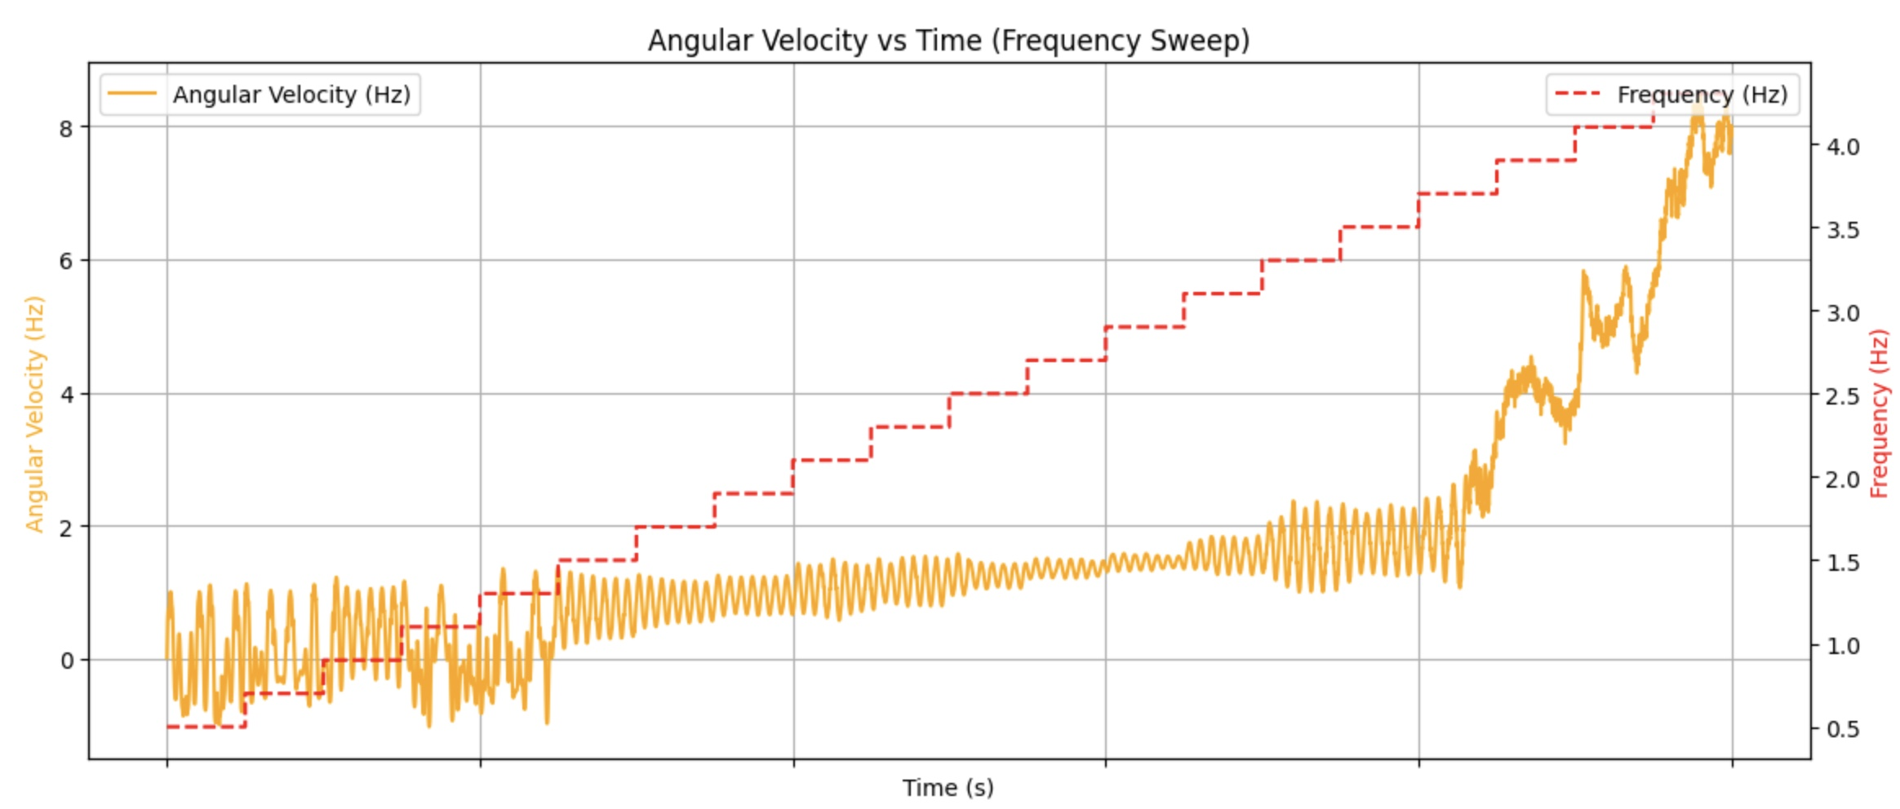
Experimenting with Parameters of Rotor System
time_span = 5s, driving frequency step = 0.2Hz, number of sampling points = 200 per second

Slide 19
Experimenting with Parameters of Rotor System
Interpretations
Increasing the number of sampling points per second does not change anything.
Minimum step-up frequency for reasonable runtime is around 0.1Hz for a time span of 10 to 30s.
Reducing number of sampling points (in this case halved) for a time span avoids expensive computation.
Negative effect in reduction of sampling points for a time span mitigated by decrease in step-up frequency.
Increase in sampling points together with decrease in frequency step sizes gives the best results (next slide). But too many sampling points does not give the best result.
Too small step size also does not give best result (0.2Hz better than 0.1Hz for time_span = 10s).
Conclusion
**Expensiveness of computation decreases with decreasing sampling points, decreasing time span and increasing step size.
**Greater delay in decay of rotor frequency caused by sufficiently high number of sampling points per second and sufficiently small driving frequency step size (sufficient information and less effects of damping caused by abruptness of driving frequency changes).

Slide 20
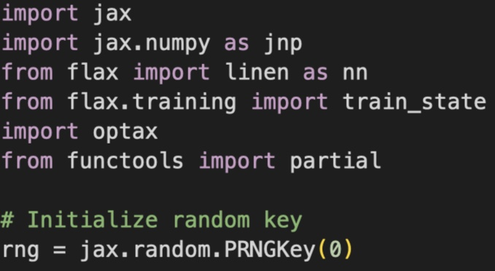
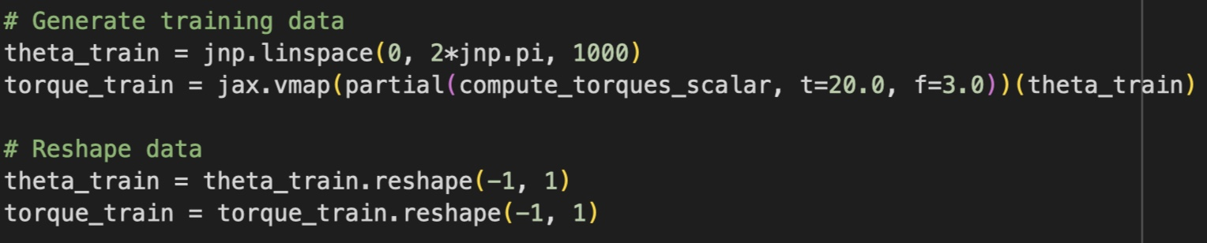
Building a Simple NN
Random initialization of weights as rng
Training Data with choice of t and f

Slide 21
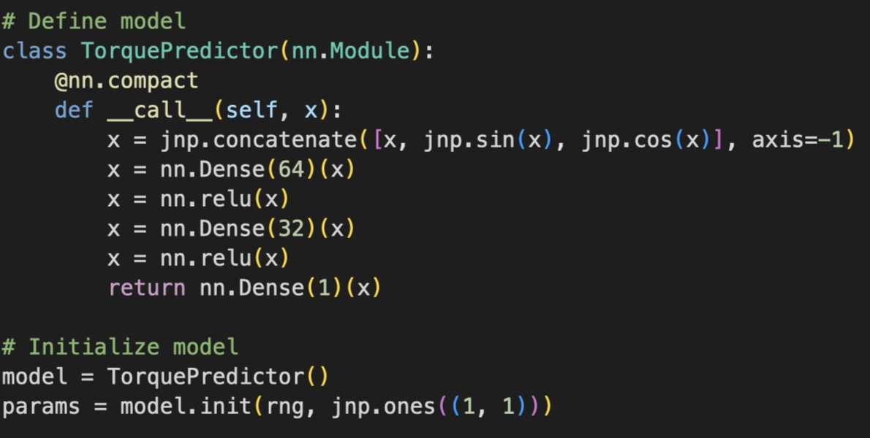
Building a Simple NN
Note: Periodicity of torque function

Slide 22
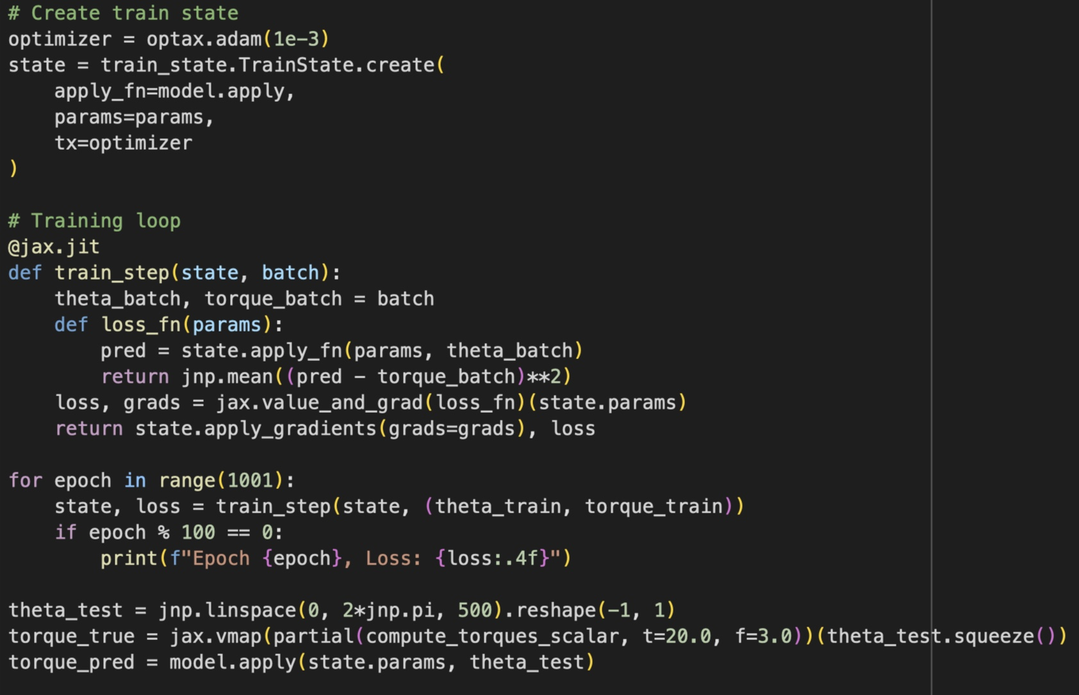
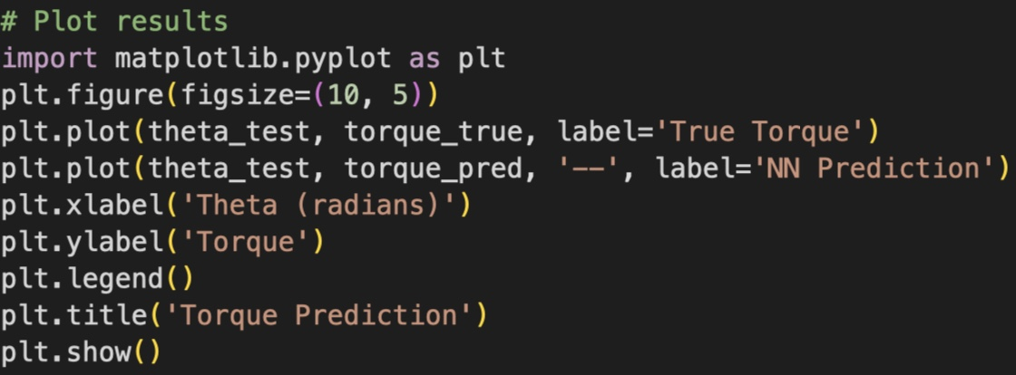
Building a Simple NN
Training of neural network
Graphical comparison

Slide 23
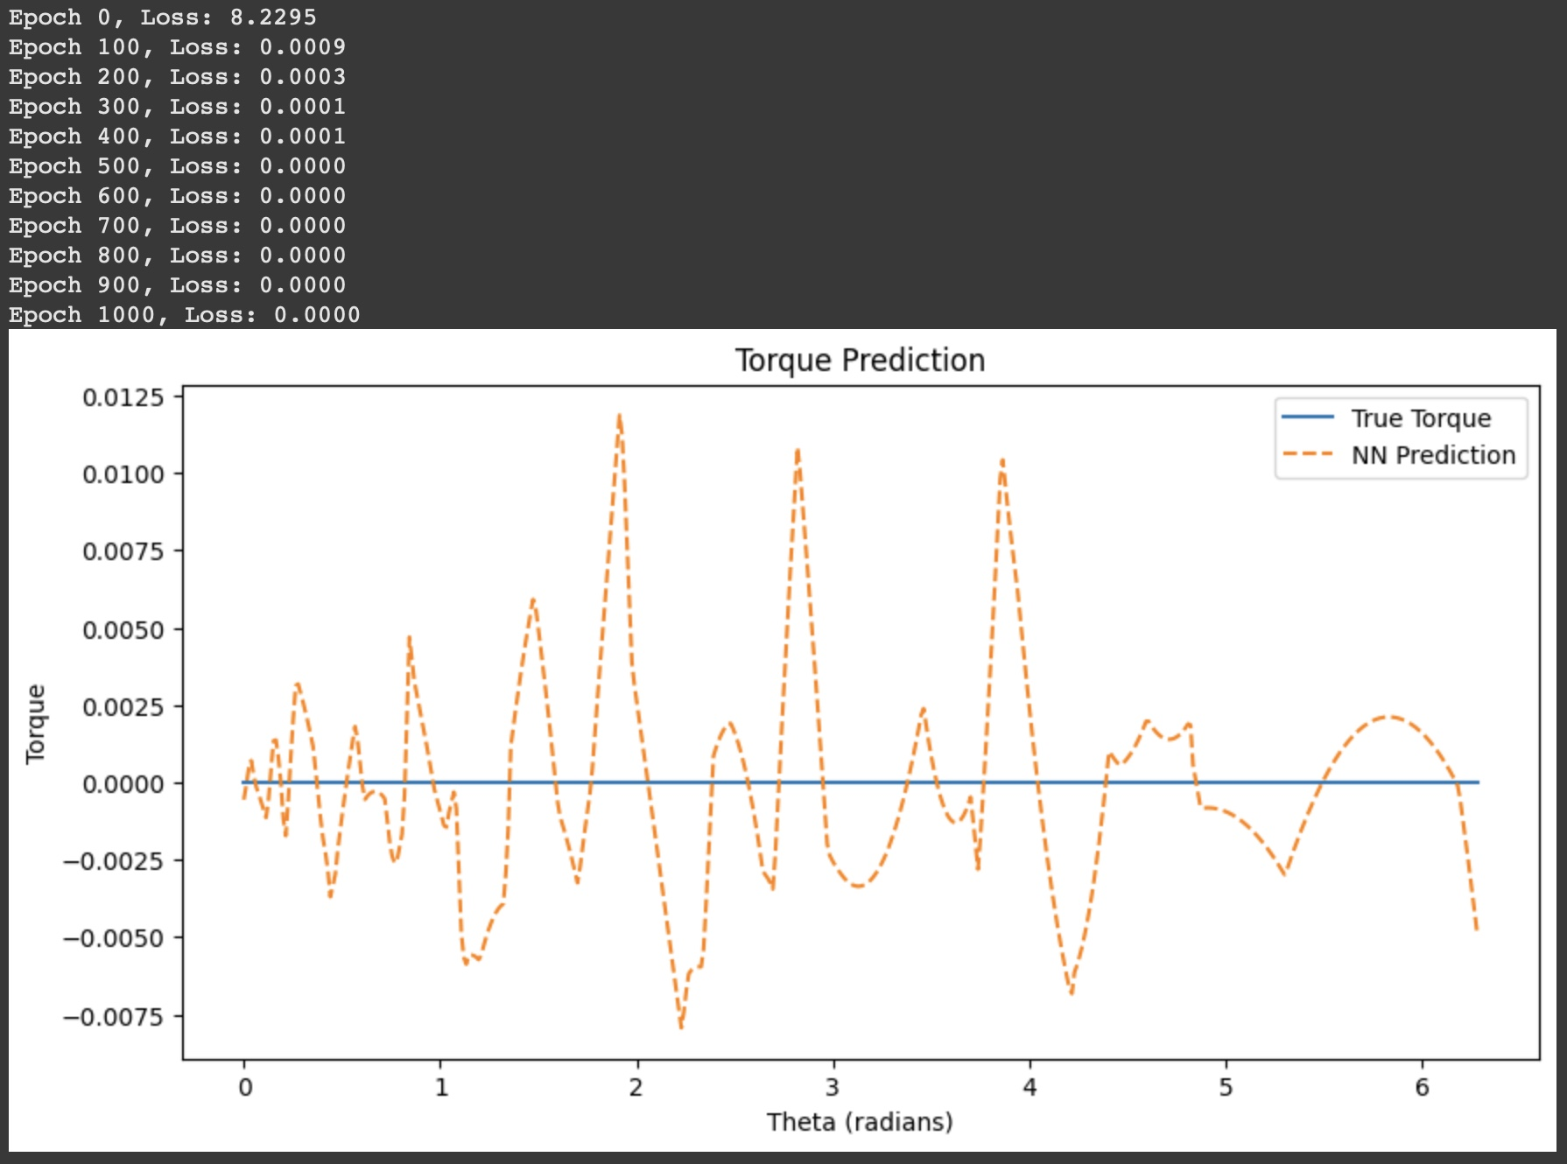
Building a Simple NN

Slide 24
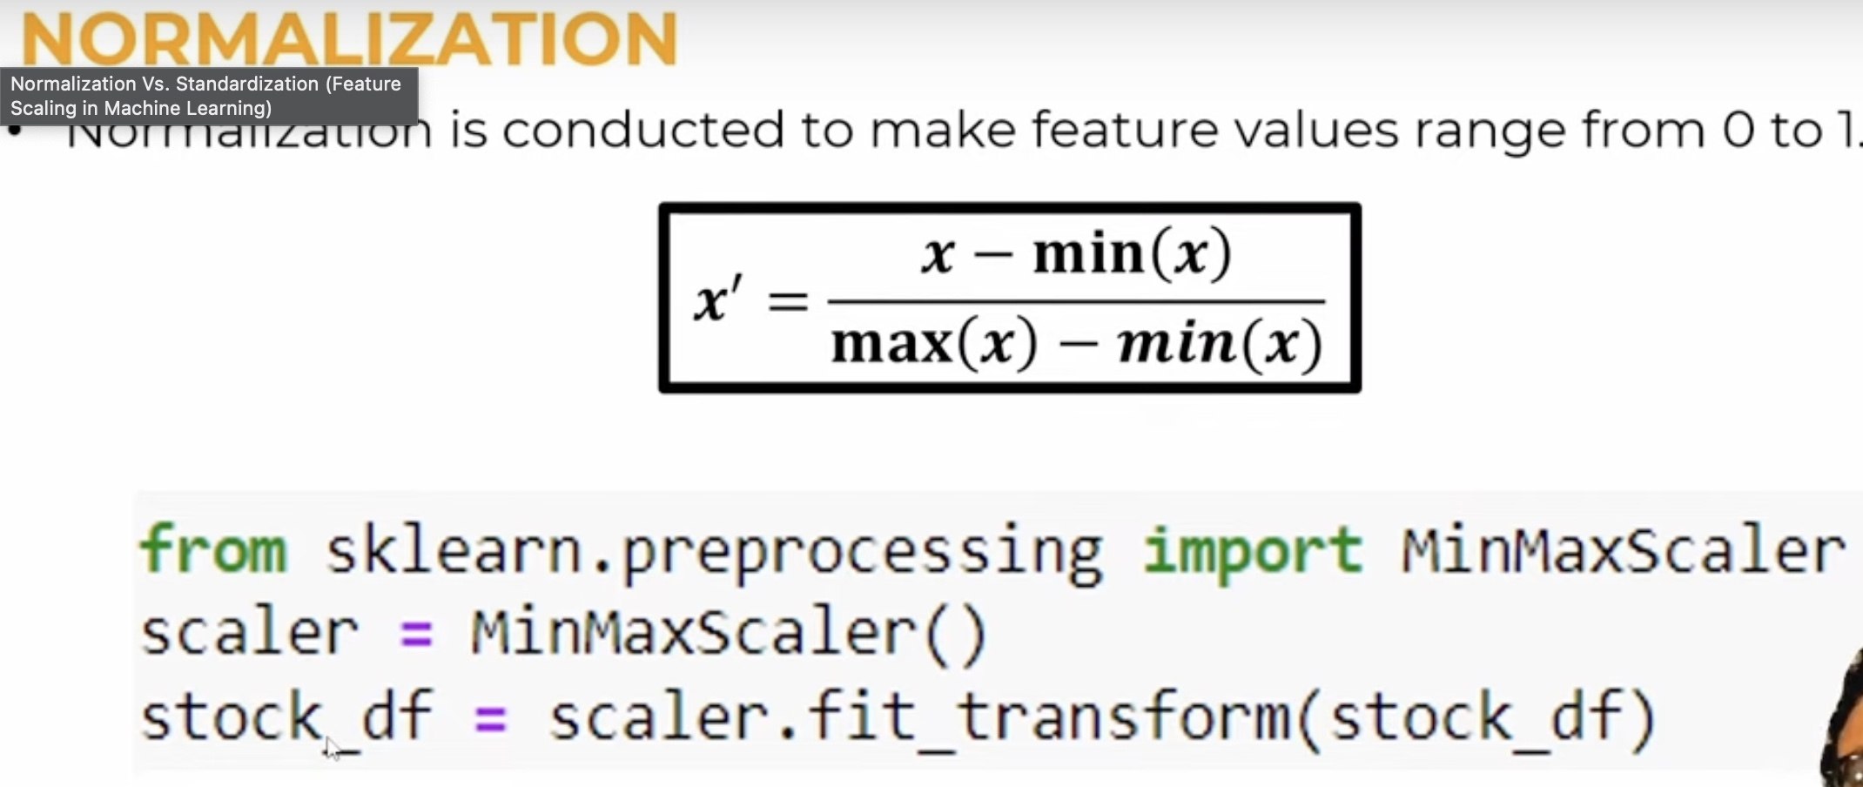
Building a Simple NN
Min-Max Normalization/Scaling

Slide 25
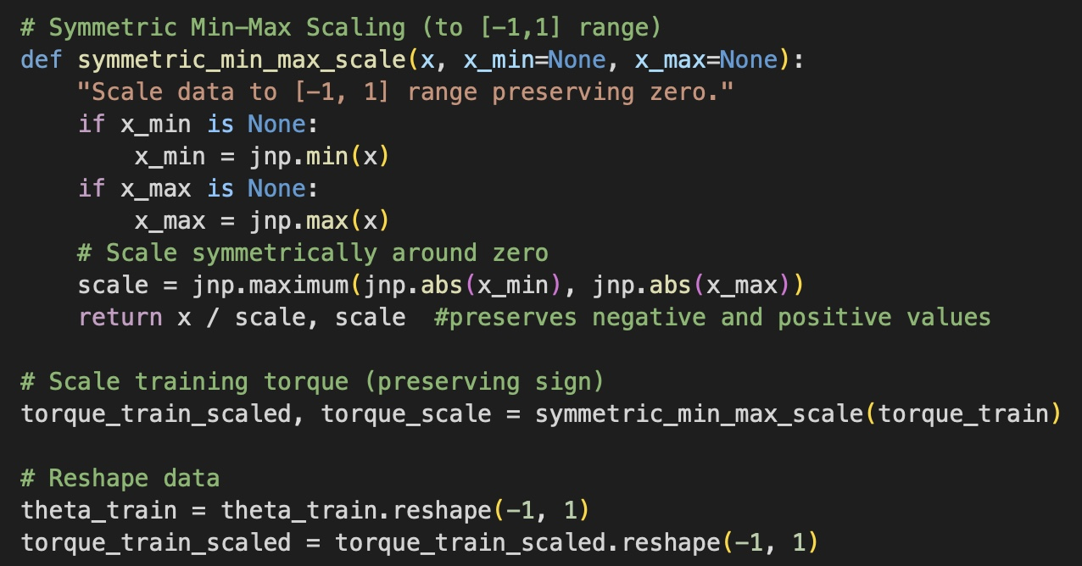
Building a Simple NN
Min-Max Normalization/Scaling

Slide 26
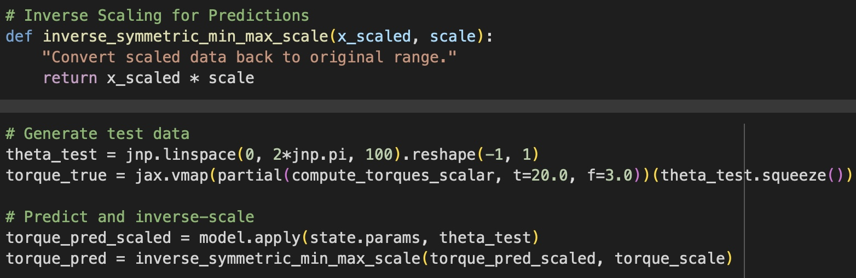
Building a Simple NN
Min-Max Normalization/Scaling

Slide 27
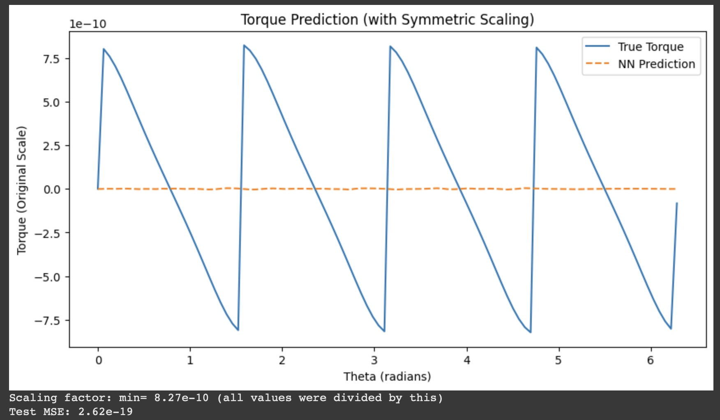
Building a Simple NN
Min-Max Normalization/Scaling

Slide 28
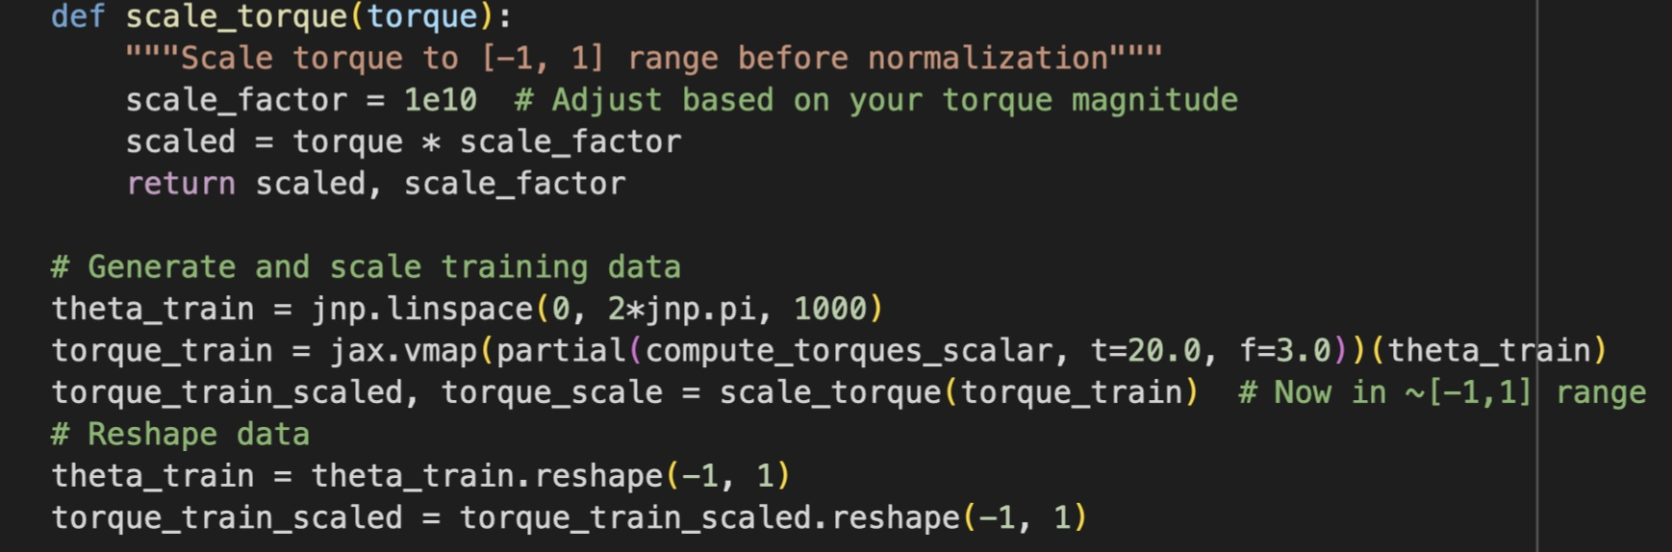
Building a Simple NN
Re-evaluation of Scaling

Slide 29
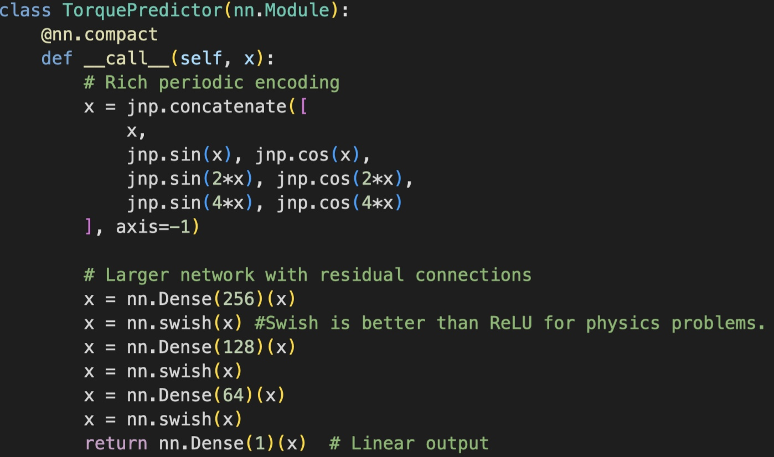
Building a Simple NN
Swish is continuous and differentiable. Better gradient flow.
Re-evaluation of Scaling

Slide 30
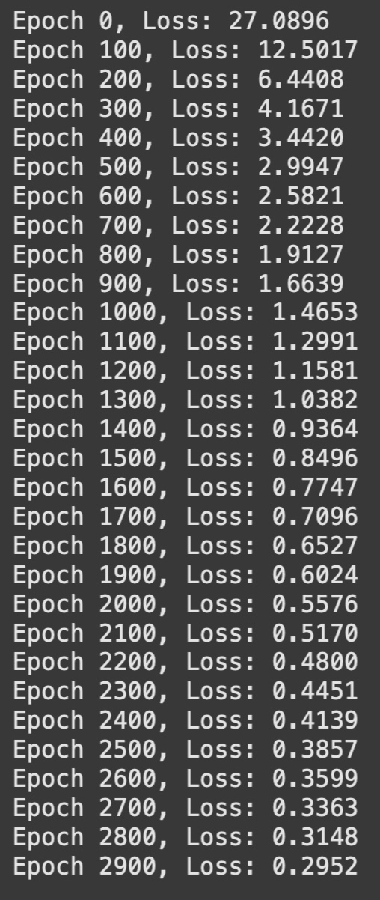
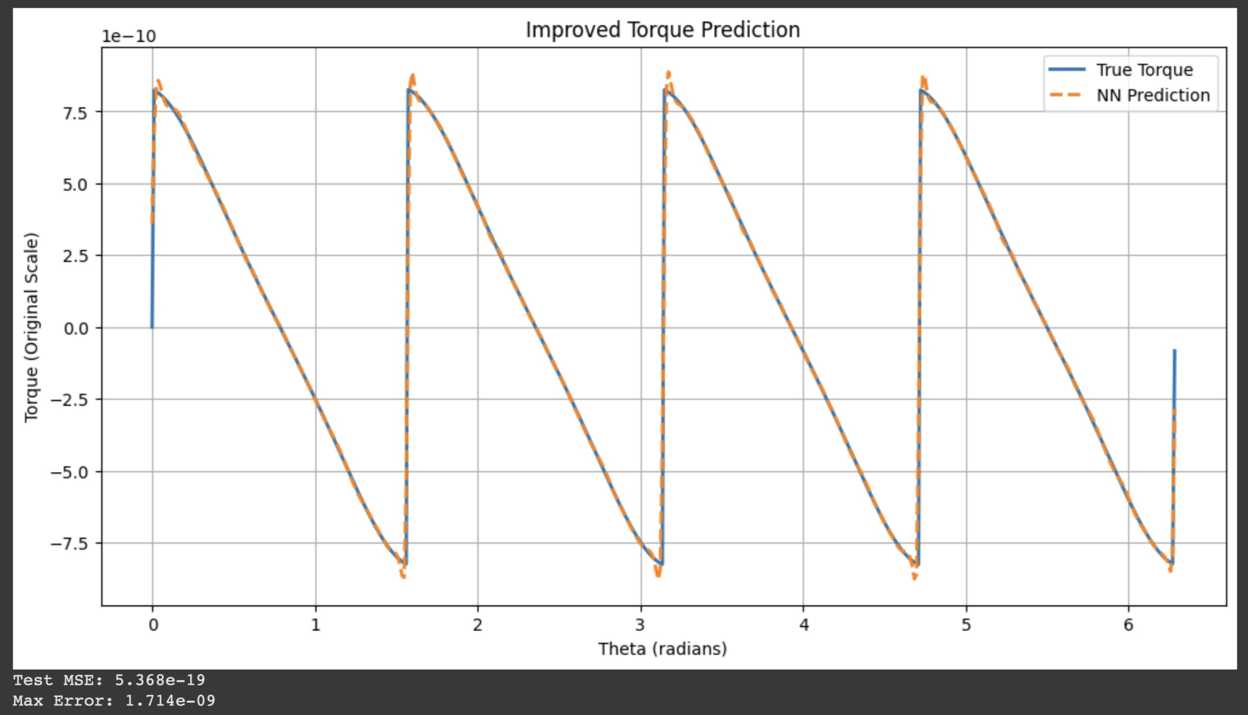
Building a Simple NN
Accurate Prediction of Torques!

Slide 31
Next Step...
Use of actual experimental data by collaborators to find the data-driven component function in the APHYNITY Model
Begin with only predicting the torque first (same as what has been done here)?

